Slide 1
BUILDING AN INNOVATION CULTURE
Leadership Innovation Track
Sept 23, 2022
Notes:
Hello innovators, my name is Steve McDonald and I will be your host through this innovation case study. Thank you for taking the time today to take a look at a case study with me and pull out a few valuable lessons.
(be sure add case study everywhere, not just imply it)

Slide 2
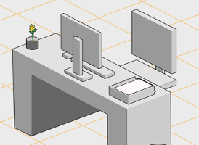
Welcome
Identify Innovation Factors
Isolate Innovation Pitfalls
Operationalizing Innovation Tactics
In conclusion
Notes:
This is a case study. So I am going to take you though a real-world experience for setting up a team and helping to establish a culture of innovation.
We will look at…
Innovation Factors – emphasis on framing products and challenges
Innovation Culture Pitfalls – moving as a leader to rewarding collaboration and motivating teams
Finally some operational Tactics – where to contribute value as a leader and when to focus on empowering

Slide 3
Welcome and Introduction

Slide 4







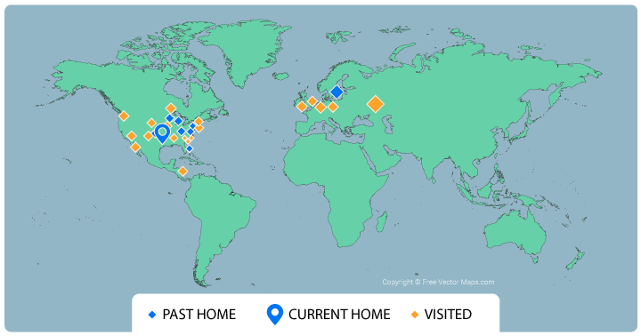






Presenter – Steve McDonald
Agile Coach
Notes:
Here is a bit about me.
I am an agile coach for OTU. I started my career in software and web development. You can see my degrees and certifications here as well as a few of the companies I have worked with.
But enough about me!

Slide 5

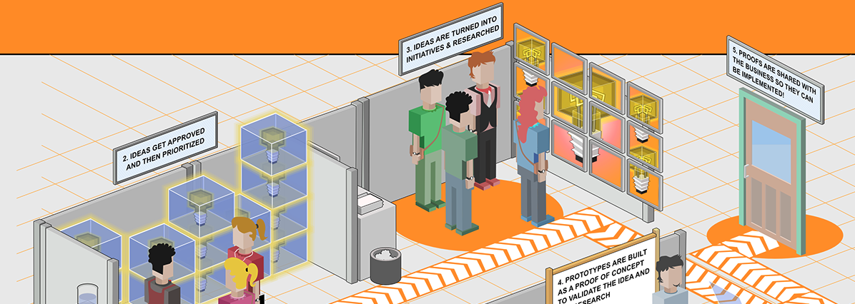
IDENTIFY FACTORS
THE INNOVATION LAB STORY
Notes:
I was working as both an IT Web Operations and Development Manager, and the Web Product Owner for a Pharmacy Benefits Management company.
We 12 Different Website templates serving members, providers, partners, and plans with hundreds of instances.
It Leadership approached me wanting to build a new product introduction team, and so the Innovation Lab was born.
In this first section, I am going to highlight some innovation factor lessons learned from launching that lab.

Slide 6
IDENTIFY FACTORS
GOALS AND CHALLENGES
GOALS
Lower the cost for members (PBM)
Desire to be viewed as a market leader
Maximize the utilization of existing information
CHALLENGES
Spin-up innovative solutions more quickly
Adopt new practices and technology where needed
Learn from our users
Notes:
When leadership got together with the initial team to lead the new Innovation lab, we talked through the vision and goals. We wanted to be clear that everything we were about to take on fit into our goals and each initiative worked diligently to overcome a few known challenges.
Highlight the slide contents

Slide 7

IDENTIFY FACTORS
SOLUTIONS
THREE OPTIONS IDENTIFIED
RE-ORG: Restructure departments and teams
OUTSOURCE: Bring in new temporary resources to innovate
INCUBATE: Try a series of changes as experiments
WHICH APPROACH (DO YOU THINK) WON?
INCUBATE
Try a series of changes as experiments.
Building a new team from existing staff.
Notes:
With the goals and challenges in mind, we came up with a few ways to begin.
First Options > Annotate > Stamp > put a star by which approach, if given the latitude to try anything, you might have selected.
The Incubator solution won the day.

Slide 8


IDENTIFY FACTORS
TAKE - AWAYS
Set Product Boundaries
Establish a strong vision with clear goals. A clearly defined product guides the investment of time and resources.
TIP: Invest in vision. Ensure your team knows and can quote the vision.
Notes:
This leads me to my first factor. (read slide)
Establishing a group with good clarity helps to focus our innovation so we are more likely to pull off the outcomes we want.

Slide 9

IDENTIFY FACTORS
FIRST INITIATIVE
GOALS
Build a mobile app for our PBM members
Not a great starter goal!
REVISED GOALS
Lower medication costs for members by comparing pharmacies and mail-order costs
Where and when they need it
Notes:
Bonus: Not every initiative is as thrilling as a shiny new thing. Types of Innovation: https://hbr.org/2017/06/the-4-types-of-innovation-and-the-problems-they-solve
Let’s jump to the fun part of this case study: our first initiative as the Innovation Lab.
(talk about the initial goal and how we moved away from targeted outputs and toward clearly defined goals for the initiative)
For those of you who attended the earlier Encouraging innovation session with Milan, think back to the LA Health Club Shampoo Problem and how if they focused on the solution first, rather than the clarifying the challenge first, the solution would have been far more costly and slower to deliver.

Slide 10

IDENTIFY FACTORS
TAKE - AWAYS
Set Product Boundaries
Define Challenge Boundaries
Establish a strong vision with clear goals. A clearly defined product guides the investment of time and resources.
Set direction using clear challenges, not solutions. There are always many ways to solve for challenges. Save solving for later.
TIP: Obsesses over the clarity of the challenge. Constraining the challenge give freedom to the solution.
Notes:
This brings us to my second factor (read slide)
As leaders, we are empowering different roles at different levels to maximize total innovation. This is where innovation starts.

Slide 11
IDENTIFY FACTORS
FIRST INITIATIVE
This is central to everything!
Partnerships
Activities
Value Props
Relationships
Customer
Pharmacy network
Mail-order network
Maintaining Info on formularies, pharmacies
Claims rules
Lower medication costs for members
Where and when they need it
Drug Sourcing Intelligence
Best Price analysis
Low-cost service support
Members
Providers
Resources
Channels
Formularies
Pharmacies
Claims processing
Mail-order
Doctor office
Pharmacy
Costs
Revenues
Ongoing Development
Mock claims processing
Rebates
Specialty
Mail-order
Savings metrics
Notes:
To set teams up for success, we needed a way to be sure everyone understood different key aspects of the initiative.
This is the business model canvas. I was the person on the innovation lab leadership team who found this tool and implemented it back in 2017/2018.
It seemed to systemically identify the scope and target surface area of impact for new opportunities.
(click to animate)
Make note that at the core, we needed a few clear value propositions and those were our updated initiative goals.
Identifying the target customers was also important. Different people needed to see similar outcomes for different reasons and we wanted to examine that to understand what the differences could be.

Slide 12
IDENTIFY FACTORS
FIRST INITIATIVE
Value Props
Same need
Lower medication costs for members
Where and when they need it
Different audience
As a PBM MEMBER
I need to find the lowest cost source for a new medication my doctor is prescribing so I can save money
As a PROVIDER
I need to find the lowest cost source for a new medication for my patient so I can help them save money
Lesson: Encourage challenge identification first, and solutions show up later on.
Notes:
So lets look at what those outcomes look like relative to our two target audience.
(Click 2 times to see both)
Pretty similar. It ends up the provider was really just a proxy for the PBM member. They simply wanted to help the member achieve their outcomes for the same reason. This means we can really drop the proxy audience goal.
(click)
What you might notice from these stories is that, at a leadership and stakeholder level, we are focus on identifying as clearly as possible the challenge, as opposed to drafting a requirement that is solution-oriented.
If this were a sport, then we are like a referee being sure everyone knows the rules and the boundaries so the team can play their best game.

Slide 13

IDENTIFY FACTORS
TAKE - AWAYS
Set Product Boundaries
Define Challenge Boundaries
Be purpose and user centric
Establish a strong vision with clear goals. A clearly defined product guides the investment of time and resources.
Set direction using clear challenges, not solutions. There are always many ways to solve for challenges. Save solving for later.
Avoid targeting only what the challenge is. Be sure and include WHO’S challenge it is and WHY, or for what reason, the challenge is important.
TIP: Embrace empathy as your context.
Notes:
This brings us to our third factor. (Read slide)
Discuss why the WHO and WHY are important.
Now, depending on where you sit as a leader, you might be thinking, ”I don’t attend sessions with teams clarrifying product boundaries or challenge boundaries, or ensuring each product backlog item is defined in a prupose and user centric manner.” and that is probably a good thing. Let them be self-organizing in those ways. BUT as a leader, you need to do all you can to build and encourage a culture that thinks like this. There are lots of questions you can ask and priorities you can set that establish these expectations in a cultural sense.

Slide 14
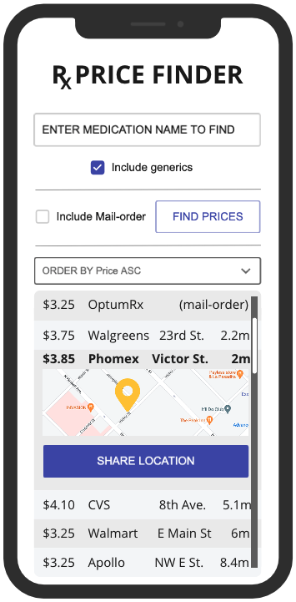
IDENTIFY FACTORS
FIRST INITIATIVE
Solutions | Lower cost | Wherever whenever | Utilize Insights | New Tech | Market Leader | Spin-up Fast
Web Page | + | - | + | - | - | +
Phone App | + | + | + | + | + | -
Hybrid App | + | + | + | + | + | +
Best hypothesized solution
Notes:
When a team reviewed the challenge, part of their effort to refine their understanding included starting the act of innovation. They needed to find the best approach. Not the most common, but the best, most well aligned approach, and there were a few.
Here is a quick cross section of a few solution approaches we all might find familiar. (read over the slide)
Notice the alignment we get out of the bottom option. (click)
It aligns to both the specific need of the initiative, as well as the goals outlined for the Innovation Lab.

Slide 15
IDENTIFY FACTORS
FIRST INITIATIVE
SOLUTION OPTIONS IDENTIFIED BY THE TEAM DURING REFINEMENT
Web Page: Not great on-the-run solution
Native Mobile App: Slower to produce and approve
Hybrid Web App: Mobile experience, with quicker wins
WHICH APPROACH (DO YOU THINK) WON?
Hybrid Web App
Can iteratively deliver new features more quickly.
Can get feedback in a more timely manner.
Notes:
So, to recap…
(quickly read through the top to review strengths and weaknesses)
Which approach might you have selected? Go ahead an stamp a star on the row that feels right to you.
(click)
(Talk about why the third solution approach was selected.)

Slide 16
IDENTIFY FACTORS
Backlog challenges align to users, and leave the most room for innovation
FIRST INITIATIVE
to move my prescription
As a PBM member I need so I can…
to sort results by distance
As a PBM member I need so I can…
to see my prescriptions
As a PBM member I need so I can…
to setup a preferred pharmacy
As a PBM member I need so I can…
Notes:
(start clicking to reveal 4 challenges)
Another enormous benefit of writing out our backlog as challenges in this solution-agnostic manner is that when the team goes to work, it is much easier to identify the next focused challenge, and the next focused challenge. This is what helps us get our solution out there and learn from our users.
(5th and final click)
If we had focused on the solution and said “Build a mobile app” or even “build a website” or “build a page” it would be far less clear for how to break up the work into these focused deliverables where we can focus on the new deliverable and see if users are getting the outcomes they want and need.

Slide 17

IDENTIFY FACTORS
TAKE - AWAYS
Set Product Boundaries
Define Challenge Boundaries
Be purpose and user centric
Ask for Alignment
Establish a strong vision with clear goals. A clearly defined product guides the investment of time and resources.
Set direction using clear challenges, not solutions. There are always many ways to solve for challenges. Save solving for later.
Avoid targeting only what the challenge is. Be sure and include WHO’S challenge it is and WHY, or for what reason, the challenge is important.
Teams define solution and produce outputs. But outputs only get you halfway there. Get past team outputs and ask for solution outcomes!
TIP: Don’t obsess over superficial parts of that thing, but over what that thing achieves.
Notes:
So this brings us to our last case study factor (read the slide)
(talk about what makes the above tip more powerful than having a boundaryless brainstorming session)
As a leader, we need to see outputs from the team. But outputs only facilitate outcomes. So we want that built into the culture.

Slide 18
IDENTIFY FACTORS
FIRST INITIATIVE
WHICH ALIGNS BETTER? (TOP OR BOTTOM)
FACTORS RECAP
OUR PRODUCT…
…meets the industry need for mobile apps that users desire in our marketplace experience. Our teams are formed around meeting that technical need.
OUR CHALLENGE…
OUR SOLUTION…
…helps lower the cost of medications for our customers by putting the right insights and information in front of them wherever they are.
OUR WORK…
( More user and service centric)
Notes:
This one is about setting product boundaries. Which of the two paragraphs feel like the Innovation Lab would be setting product boundaries?

Slide 19
IDENTIFY FACTORS
FIRST INITIATIVE
WHICH ALIGNS BETTER? (TOP OR BOTTOM)
FACTORS RECAP
OUR PRODUCT…
…helps PBM members lower the cost of their medications by identifying prices at local and mail-order pharmacies in the moment they need to find that information.
OUR CHALLENGE…
(more challenge and outcome centric and less solution centric)
OUR SOLUTION…
…is a mobile app for iPhone that will identify pharmacies or mail-order providers that sell those medications and the lowest cost.
OUR WORK…
Notes:
This one is about setting challenge boundaries. Which of the two paragraphs feel like the Innovation Lab would be setting good challenge boundaries?

Slide 20
IDENTIFY FACTORS
FIRST INITIATIVE
WHICH ALIGNS BETTER? (TOP OR BOTTOM)
FACTORS RECAP
OUR PRODUCT…
…is defined by specific user interface expectations outlined in a business requirements document that the team feels they can create in a two-week sprint.
OUR CHALLENGE…
OUR SOLUTION…
…aims to find lowest-cost medications for PBM members who needs to find local or mail-order providers because they need to keep their pharma-costs low
OUR WORK…
(easier to see alignment with the challenge and outcome focused)
Notes:
This one is about being purpose and user centric. Which of the two paragraphs feel like the Innovation Lab would be establishing user and purpose centric solution definitions?

Slide 21
IDENTIFY FACTORS
FIRST INITIATIVE
WHICH ALIGNS BETTER? (TOP OR BOTTOM)
FACTORS RECAP
OUR PRODUCT…
…is successful if we can get something useable into production in a two-week sprint.
OUR CHALLENGE…
OUR SOLUTION…
…is successful if we have enabled our PBM members to pull off their outcomes and we remain committed to review and pursue feedback from users beyond our sprinting.
OUR WORK…
(less output focused and more outcome focused hypothesis-driven)
Notes:
This last one is about ensuring outcome alignment. Which of the two paragraphs feel like the Innovation Lab would targeting outcome alignment?

Slide 22

ISOLATE COMMON INNOVATION PITFALLS
THE INNOVATION LAB STORY
Notes:
As leadership who are trying to build a culture of innovation, lets walk through a few ideas for common pitfalls to avoid

Slide 23


ISOLATE PITFALLS
COMMON PITFALLS TO AVOID
Process can help, but also hurt
Consistent opportunity is good
Timeboxing is good
Being too prescriptive is bad
ENCOURAGE SCHEDULING INNOVATION
Notes:
Process can be very helpful to teams. Here are a few things to watch for when building your culture
Consistently making time for innovative thinking is important and helpful.
Thankfully, process frameworks like Scrum make time for innovation both in Team backlog refinement and during the sprint.
In the Innovation Lab the team started out by refining their understanding of the challenge with the Product Owner. Then they would go off and dream about how to tackle the problem. In the end, this treated the solution like it was only the interest of engineers. As the team matured, they would ideate on their solution approach together as a team and include ideas about how they would be able to test outcome alignment once they implemented the solution.
As leaders we don’t want to be prescriptive and ask them to wireframe every story in refinement. But it is reasonable to ask them to collaborate and innovate together on an approach every time. In our final session “Ideastorming” with presenter Jignesh, you experience examples for guiding groups to creativity and innovation.

Slide 24


ISOLATE PITFALLS
COMMON PITFALLS TO AVOID
Building things AND breaking things
Build on good progress
Do not fear breaking or rebuilding poor decisions
Experiments over outputs
EVERYTHING IS AN EXPERIMENT
Notes:
In an ideal world, once you innovate, all steps forward are steps upward. But that isn’t always the case, and surely isn’t always the most brave move to make.
In our example, the early prototypes for the mobile app were created using raw web development skills: HTML, CSS, and JavaScript. Later, when things got more complex, they knew they needed a framework for their mobile app and so they adopted react and were able to replatform the solution and add a new story of functionality in a single future sprint.
Think back to Milan’s 7 Fatal Flaws talk and how the remedy to Overthinkging is Prototyping and trying. Make room for it.
As a leader we want our teams to work smart. If we have an innovative solution in place, can we build on it? Excellent. Keep going.
We want to encourage the freedom of teams to break away from bad ideas. If something isn’t working, then try something new.
We want user outcomes over team outputs. And it takes experiments to try new and better ways to get users the outcomes they need.
So an innovative culture means treating everything as if it is an experiment.

Slide 25




ISOLATE PITFALLS
COMMON PITFALLS TO AVOID
Innovation is not a person
Encourage collaboration
Avoid isolation
Respond to ideas, not decisions
Specialist
Agile Dev Team
REWARD COLLABORATION
Notes:
Innovation is not a person
We had a few rockstars working in the innovation lab. And rather than have them lead every initiative or have them determine the solution each time, we had specific mentoring goals for them. They needed to learn to serve their team and help everyone rise up to higher levels of productivity and efficiency. This may have slowed down early innovation, but later it boosted innovation exponentially.
To build a culture of innovation we want staff to share insights and experiences, to riff off the lessons each of us bring.
This is not about hammer down the nail that sticks out to far.
This is about building a culture where we seek to lift each other up, and pull each other higher, through real team collaboration.
As a leader, ask for collaboration stories when things go well.
Celebrate the team collaboration and encourage the team to call out peers and their contributions, rather than you rewarding individuals.

Slide 26
ISOLATE PITFALLS
COMMON PITFALLS RECAP
INNOVATION LEADER MONTRA
As a leader I value and support…
Encouraging innovation OVER controlling the solution
Achieving outcomes OVER delivering outputs
Rewarding collaboration OVER promoting superstars
Notes:
So here is our Innovation Pitfall Recap
Think of this as a leader affirmation. (read the slide)
encouraging the right questions OVER forcing a specific answer

Slide 27

OPERATIONALIZE INNOVATION TACTICS
THE INNOVATION LAB STORY
Notes:
In the next session, you are going to spend time in a workshop experience learning some neat techniques you can promote to team-level innovators. I highly recommend attending that session to gather a great pile of resources and have some great hands-on experiences that inspire innovation.
In this final bit of my case study, we are going to go through a few innovation tactics that I discovered worked well in the Innovation Lab. The tactical focus is on what you can do as a manager or aspiring manager of innovation people, to regularly invest in your innovation culture.

Slide 28
OPERATIONALIZE TACTICS
PRODUCT OWNER COLLABORATION
Work with the Product Owner to…
Ensure the team supports the product goal
Ensure the features presented to the team are defined as challenges (not predefined solutions)
Help the team remain focused on the users’ challenge and their needed outcomes
Notes:
Hopefully most of us are relating to Scrum Teams and are motivated by the though of operational agility.
If you are a leader you might be in one of the roles I am about to mention. Let the following be an encouragement to you in that case.
In the lab we had a very mature product owner. And they knew they needed to build relationships and inspire people around the clarity of the backlog. Our PO had to work with stakeholders to codify the product vision. They had to work with stakeholders and researchers to understand audiences. All of this maximized insights and information to serve the team in finding and building well-aligned solutions. So supporting the PO as an innovation lab leader was crucial.
If you are working with a product owner – here are a few agile tactical tips for you from the Innovation lab when collaborating with the PO or PM role.
(Read and discuss slide)

Slide 29
OPERATIONALIZE TACTICS
SCRUM MASTER COLLABORATION
Work with the Scrum Master to…
Empower the team to explore solution approaches together during team backlog refinement sessions
Help the team transition from “delivering outputs” to “achieving audience outcomes” through adaptiveness in their Daily Scrum events (Daily Stand-up)
Make room for Proof of Concept and Prototyping
Notes:
Next up, if you are working with a scrum master– here are a few agile tactical tips for you when collaborating with the scrum master or RTE role.
In our lab we had a trained and experienced scrum master. They knew they were serving the team and helping everyone from stakeholders to executives and team members master scrum or maximize their interaction with scrum teams. Here are the lessons we learned as leadership supporting scrum masters.
(Read and discuss slide)

Slide 30
OPERATIONALIZE TACTICS
DEVELOPMENT TEAM COLLABORATION
Work with the Dev Team to…
Invest in cross-functional skills for team members (UX, Graphic Design, architecture, UI research)
Empower them to find a balance between building on existing solutions, and not being afraid to break away from old patterns that are no longer working
Become better listeners and collaborators
Team self-organization
Notes:
And finally, if you are working with development team members– here are a few agile tactical tips for you when collaborating with the team contributors.
Before I worked in the innovation lab, I was a manager of a Web Team as well as the PO. This was really difficult. As a manager I was trying to optimize the efficiency of the team and be sure they were allocated to work and that their hours were maximized. As a PO I needed to be sure I was prioritizing clarity and the order of value coming out of the team as they worked on the backlog items.
But with an agile team, the focuses changes. As a manager, the team is supposed to self-organize. In this sense, I am more like the chief engineer of a formula-one pit crew. I need every part of the machine resourced up and running efficiently. I am not the driver and I am not managing the engine. I had to learn how to support the team and not micro-manage team productivity. Here is what I did to work with Agile Developers better as a leader…
(Read and discuss slide)

Slide 31
OPERATIONALIZE TACTICS
INNOVATION TACTICS RECAP
INNOVATION LEADER MONTRA
As a leader I value and support…
Product Owner innovation BY focusing on a challenge-first approach
Scrum Master innovation BY promoting team experimentation
Developer innovation BY encouraging research and exploration
Notes:
Let’s do our final recap for Innovation Tactics
Again – in the style of personal innovation leader affirmations
(Read and discuss slide)

Slide 32
Closing Remarks

Slide 33


Learn more about Coaching!
OTU Coaching Services include:
Team & Leadership Coaching
Product Transformation
Organizational Change Management
DevOps Adoption and Maturity
Custom Training
UHG Agile Community provides:
Discussions with colleagues and coaches
Wiki with links to various internal resources
Files with documented proven practices
Coach’s Blog with insights on Agile topics
A sense of community and connection
Notes:
OTU Coaching Services: https://uhgazure.sharepoint.com/sites/TCO/SitePages/Coaching-Services.aspx
UHG Agile Community: https://teams.microsoft.com/l/team/19%3a7bad8cddf0ff4745807512744435fc19%40thread.tacv2/conversations?groupId=4ed65241-9ce6-4ea0-ace9-b348652c6ab5&tenantId=db05faca-c82a-4b9d-b9c5-0f64b6755421

Slide 34

Thank you!
Let us know how we did by taking the survey today!
https://www.crowd.live/3L228

